Slide 1
Nintendo Switch OLED Model
Emily Jao

Slide 2
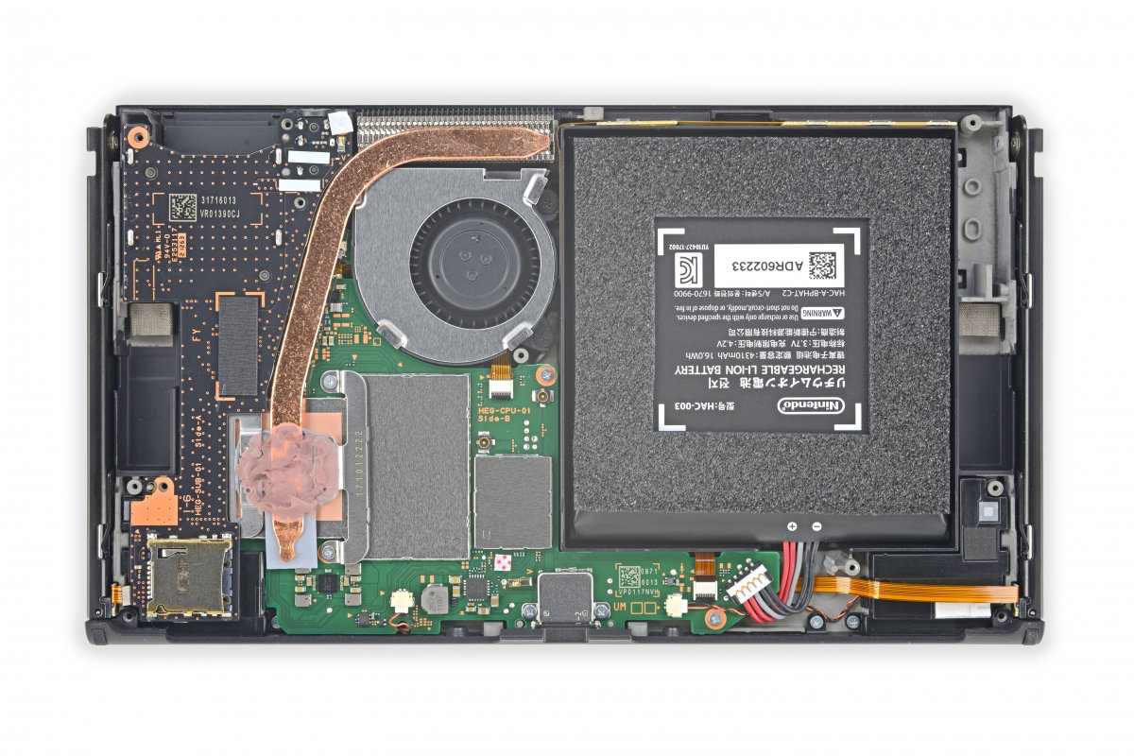
Parts
Power supply (green)
Switch OLED has 4 GB RAM and 64 GB flash storage.
CPU is NVIDIA Custom Tegra processor.
Power supply

Slide 3
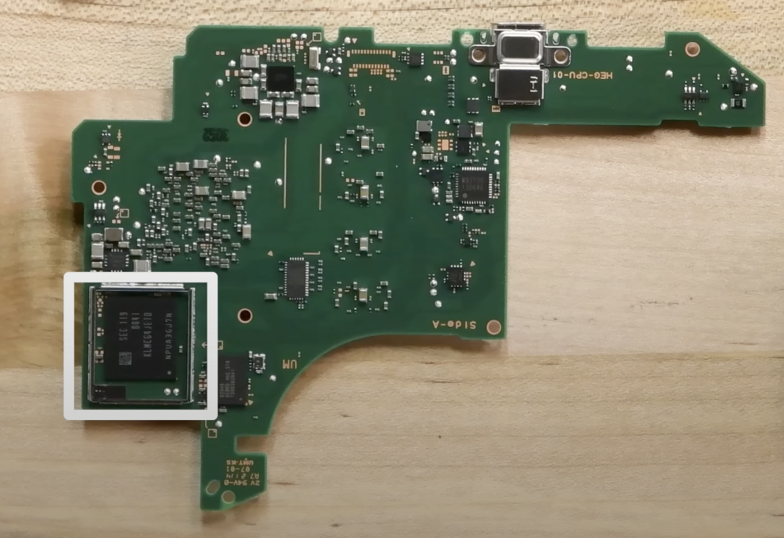
Parts
Motherboard
Motherboard (yellow)
Hard drive (orange)
CPU

Slide 4
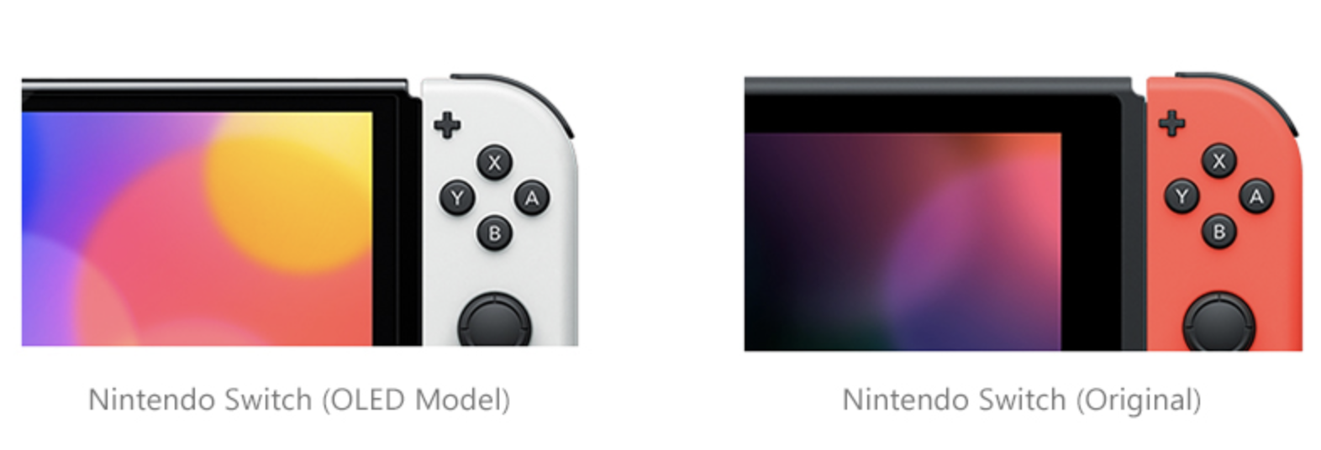
Fun fact!
I learned that the Nintendo Switch OLED model has a bigger 7-inch screen with bright colors, better sound, and bigger storage.
In comparison, the LCD model has a smaller 6.2-inch screen, smaller storage, and a weaker stand.
The OLED model is a better choice for playing games!
Enjoy Immersive Games with an OLED Display! (Nintendo Switch is Coming Soon). (2022). Samsung Display Newsroom. https://global.samsungdisplay.com/28162/
‌

Slide 5
Discussion
The inside of the device was what I expected. It seemed similar to a smaller version of a laptop's dissection.
I found it very difficult to find the internal and outer parts of the device. They are all hidden in the given picture. I also find nintendo switch to be quite a rare device to dissect, so I couldn’t really find the specific parts.
I chose the Nintendo Switch because I plan to get one this summer. I already have a Nintendo, but the Switch seems like a better option.

